Slide 1
AQA Pre-Employment
2022

Slide 2
DOCUMENT METADATA
DOCUMENT ID | 1111
TEMPLATE ID | AQA Pre-Employments 2022
CLASSIFICATION | PUBLIC/INTERNAL [4CH-INT] / CONFIDENTIAL [4CH-CNF] / RESTRICTED [4CH-RST] (most restricted access). Default: INTERNAL [4CH-INT]
REVISION NO. | 1.0
LAST MODIFIED | 20-10-2022
INFORMATION OWNER | Gyorfi Istvan / Andrei Enea
EMAIL
AUDIENCE
Revision History
REVISION | DATE | AUTHOR | REVISED BY | APPROVED BY | STATUS | DESCRIPTION OF CHANGE
1.0 | 20-10-2022 | Gyorfi Istvan | Reviser’s Name & Role | Approver’s Name & Role | Draft

Slide 3



Trainers
Andrei-Florin Enea
Gyorfi Istvan

Slide 4

Prezentari

Slide 5
Asteptarile Voastre
https://miro.com/app/board/uXjVPFuuVm8=/

Slide 6
Asteptarile Noastre
WebCam Deschis pe timpul cursului
Să va realizati temele
Sa sa fie interactivi și selflearning
Sa nu aibă alte activități în timpul cursului
Sa pună întrebări oricând pe timpul cursului dacă nu s-a înțeles ceva
Vorbim pe rând - fiecare va folosi reaction
La 3 absente sau 3 teme nefacute - se va scoate din curs
Nu intarzieti mai mult de 20 min
Sa va treceti numele complet va rog cand intrati in meeting

Slide 7

What is testing?

Slide 8
“Software Testing is an empirical technical investigation conducted to provide stakeholders with information about the quality of the product or service under test”
“Testing helps us to measure the quality of software in terms of the number of defects found, the tests run, and the system covered by the tests.”
“Quality is the degree to which a component, system or process meets specified requirements and/or user/customer needs and expectations.“
Foundations of Software Testing ISTQB Certification

Slide 9
What is testing?
Test input
Software under test
Test output
Output is ok?
Debug
yes
no

Slide 10
What is testing?
Bugs = Defects = an error or mistake in using the software, that may lead directly to a problem; the software is used incorrectly and so does not behave as we expected.
When do defects arise?
• errors in the specification, design and implementation of the software and system;
• errors in use of the system;
• environmental conditions;
• intentional damage;
• potential consequences of earlier errors, intentional damage, defects and failures;

Slide 11
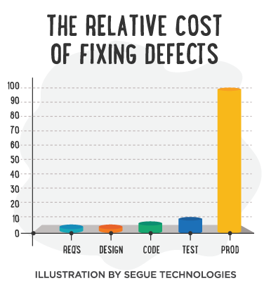
What is testing?

Slide 12
What is testing?
Principles of testing:
Testing is context dependent
Exhaustive testing is impossible
Early testing
Defect clustering
Pesticide paradox
Testing shows presence of defects
Absence of errors fallacy

Slide 13
What is testing?
Why are we testing?
Find important bugs
Assess the quality of the product
Help managers assess the progress of the project
Help managers make release decisions
Block premature product releases
Help predict and control product support costs
Check interoperability with other products
Find safe scenarios for use of the product
Assess conformance to specifications
Certify the product meets a particular standard
Ensure the testing process meets accountability standards
Help clients improve product quality & testability
Help clients improve their processes
Evaluate the product for a third party

Slide 14
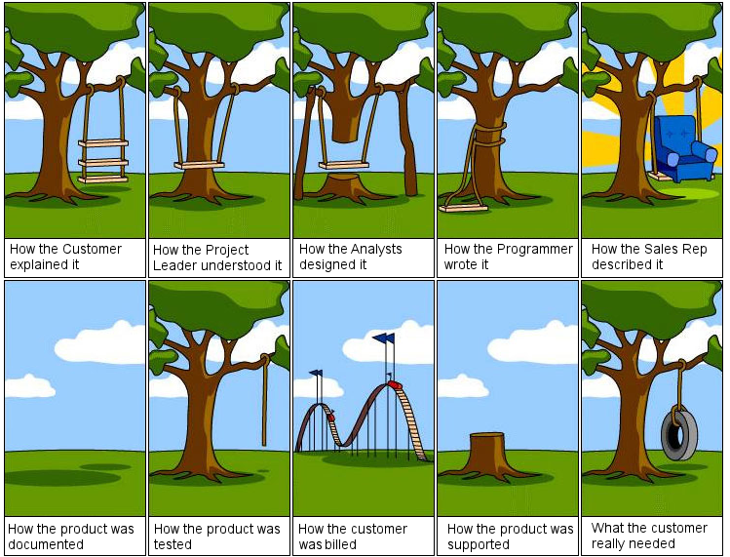
What is testing?

Slide 15
Test levels

Slide 16
Test levels
In software development life cycle models there are defined phases like requirement gathering and analysis, design, coding or implementation, testing and deployment.
Testing levels are basically to identify missing areas and prevent overlap and repetition between the development life cycle phases.
Each phase goes through the testing. Hence there are various levels of testing.

Slide 17
Test levels
4 generally recognized levels of tests:
Unit
Integration
System
Acceptance

Slide 18
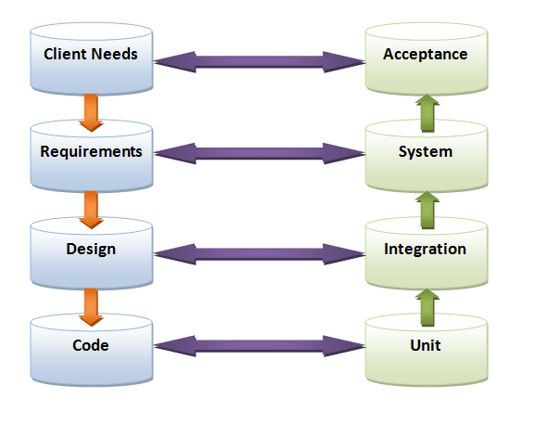
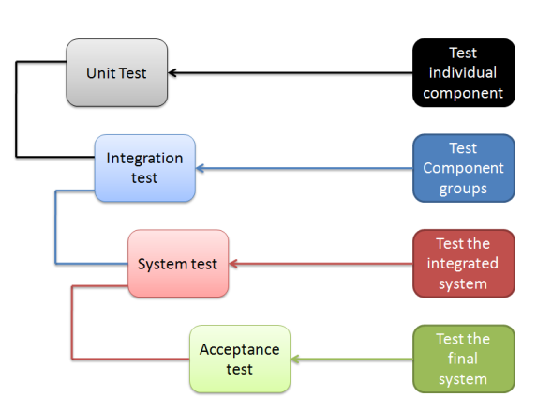
Test levels

Slide 19
Unit testing
used to validate that a particular module of source code is working properly;
test cases for all functions and methods
useful for regression testing.

Slide 20
Unit testing
goal :
to test each part of the program in isolation;
prove that individual parts are correct.
benefits:
facilitates changes (decreases risks);
simplifies integration;
separation of testing the Interface from Implementation.

Slide 21

Unit test design
What can we test for a function / method ?
What tests can we design ?

Slide 22
Unit test design
Tests can be designed to verify:
general correctness
boundary conditions
error conditions

Slide 23
integration testing
Integration testing is a logical extension of unit testing.
Evaluates interaction between components (software components, hardware components, or both);
Goal is to verify that real world workflows are successful.

Slide 24
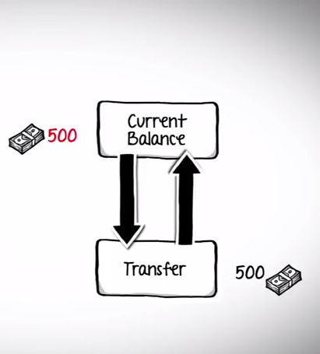
integration testing
Example

Slide 25
integration testing
Two approaches:
Bottom-up integration testing: requires the lowest-level units be tested and integrated first. These units are frequently referred to as utility modules.
Top-down integration testing: Testing takes place from top to bottom, following the control flow or architectural structure (e.g. starting from the GUI or main menu).

Slide 26
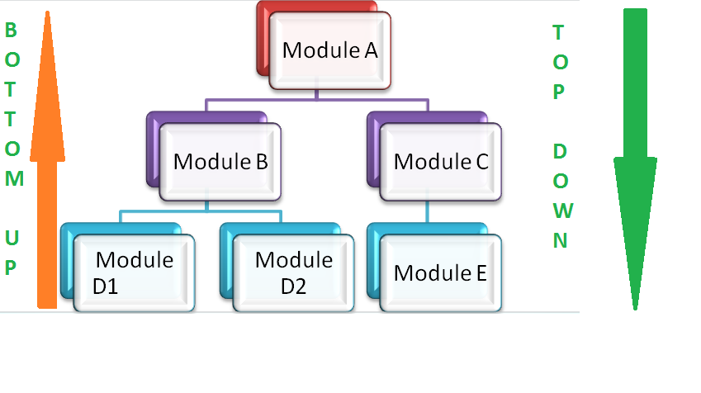
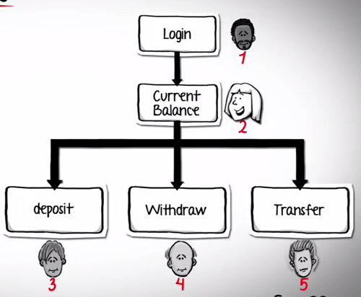
integration testing

Slide 27
System testing
Conducted on the integrated system;
Investigate both functional and non-functional requirements of the software;
Challenge the behavior of the system based on believed expectations of the customer;
System is tested in an environment that particularly resembles the effective production environment

Slide 28
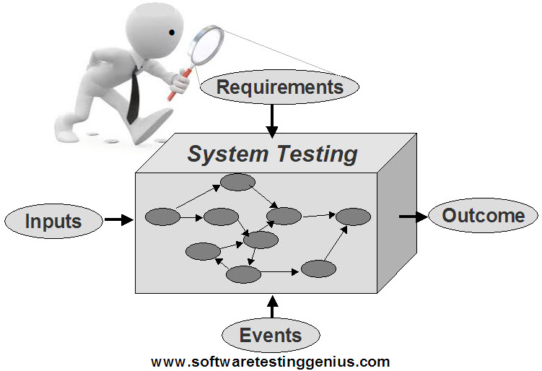
System testing

Slide 29
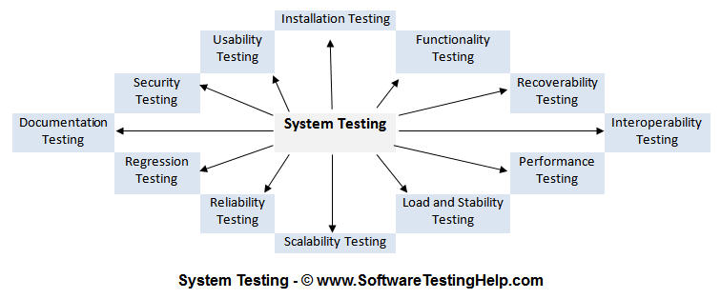
System testing
Different type of testing:
Functional testing, Regression testing, Smoke testing, Sanity testing, Ad-hoc testing, Exploratory testing, Usability testing, GUI software testing, Compatibility testing, Performance testing, Load testing, Stress testing, Volume testing, Error handling testing, Scalability testing, Security testing, Capacity testing, Installation testing, Recovery testing, Reliability testing, Accessibility testing

Slide 30
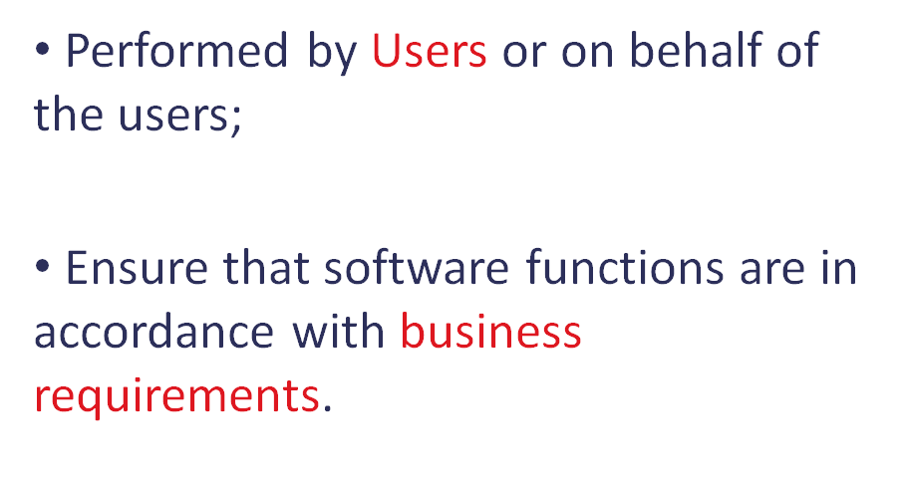
User acceptance testing

Slide 31
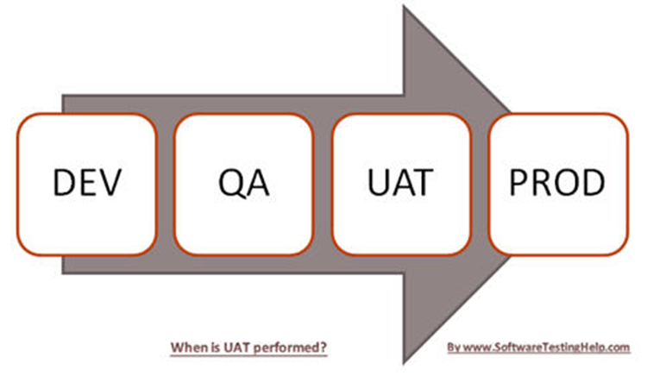
User acceptance testing

Slide 32
User acceptance testing
UAT focuses on:
functional requirements are satisfied;
performance requirements are satisfied;
other req. like compatibility, error recovery, etc are satisfied;
acceptance criteria specified by the user is met.

Slide 33
Test Types

Slide 34
Test types
A test type is focused on a particular test objective, which could be the:
testing of a function to be performed by the component or system;
a nonfunctional quality characteristic, such as reliability or usability, security;
the structure or architecture of the component or system;
related to changes, i.e. confirming that defects have been fixed (confirmation testing, or re-testing) and looking for unintended changes (regression testing).
Foundations of Software Testing ISTQB Certification

Slide 35
Test types
A test type is focused on a particular test objective, which could be the:
testing of a function to be performed by the component or system;
a nonfunctional quality characteristic, such as reliability or usability, security;
the structure or architecture of the component or system;
related to changes, i.e. confirming that defects have been fixed (confirmation testing, or re-testing) and looking for unintended changes (regression testing).
Foundations of Software Testing ISTQB Certification

Slide 36
Functional testing
Functionality testing can be done focusing on :
What the system does?
Accuracy
Functionality Compliance
Interoperability
Security
Suitability

Slide 37
Functional testing
Requirement-Based Testing
Verify that a software application performs and functions correctly according to requirements, design specifications.
Business-process-based Testing
Verify business workflows

Slide 38
Functional testing
Smoke Testing
Sanity Testing
Exploratory Testing
Unit Testing
Integration Testing
Interface Testing
Accessibility Testing
System Testing

Slide 39
NON-Functional testing
Non-functionality testing can be done focusing on :
How well the system behaves?
Reliability
Usability
Efficiency
Maintainability
Portability

Slide 40
NON-Functional testing
Performance Testing
Security Testing
Penetration Testing
Scalability Testing
Usability Testing
Internationalization Testing
Maintainability Testing
Portability Testing
Recovery Testing
Load testing / Stress testing

Slide 41
structural testing
Structural testing focuses on:
What happens inside the code?
White box testing technique which takes into account the internal structure of a system or component and ensures that each program statement performs its intended function.

Slide 42
structural testing
Control flow testing uses the control structure of a program to develop the test cases for the program. The test cases are developed to sufficiently cover the whole control structure of the program:
Statement coverage
Decision coverage
Path coverage

Slide 43
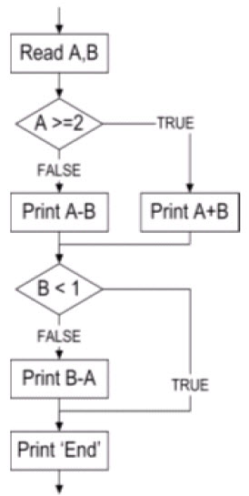
structural testing

Slide 44
structural testing
Data flow testing focuses on the points at which variables receive values and the points at which these values are used
Data Flow testing helps us to pinpoint any of the following issues:
A variable that is declared but never used within the program.
A variable that is used but never declared.
A variable that is defined multiple times before it is used.
Deallocating a variable before it is used.

Slide 45
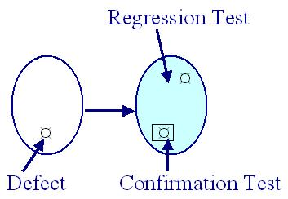
Change related testing
Confirmation Testing
Regression Testing

Slide 46

Automation testing

Slide 47
Automation testing
Run many test cases on different versions
Without human interaction
Performed at different levels
Shortening the testing period
Not all manual test can be automated

Slide 48

Test cases

Slide 49
Test cases
“A set of conditions under which a tester will determine whether an application, software system or one of its features is working as it was originally established for it to do.”
“A test case consists of a set of input values, execution preconditions, expected results and execution postconditions, defined to cover a certain test objective(s) or test condition(s), such as to exercise a particular program path or to verify compliance with a specific requirement.”
Foundations of Software Testing ISTQB Certification

Slide 50
Test cases
WRITING GOOD TEST CASES
Write test cases in such a way that you test only one thing at a time.
Do not overlap or complicate test cases. Attempt to make your test cases ‘atomic’.
Ensure that all positive scenarios and negative scenarios are covered.
Language:
Write in simple and easy to understand language.
Use active voice: Do this, do that.
Use exact and consistent names (of forms, fields, etc).
Characteristics of a good test case:
Accurate: Exacts the purpose.
Economical: No unnecessary steps or words.
Traceable: Capable of being traced to requirements.
Repeatable: Can be used to perform the test over and over.
Reusable: Can be reused if necessary.

Slide 51
Test cases
How to write a test case?
Typical Test Case Parameters:
Test Case ID
Test Scenario
Test Case Description
Test Steps
Prerequisite
Test Data
Expected Result
Test Parameters
Actual Result
Environment Information
Comments

Slide 52
Test cases
How to execute a test case?
Create test suites from the test cases for efficient test execution
Based on a risk, select a subset of test suite to be executed for this cycle
Execute tests, report bugs, and capture test status continuously

Slide 53
Test Design techniques

Slide 54
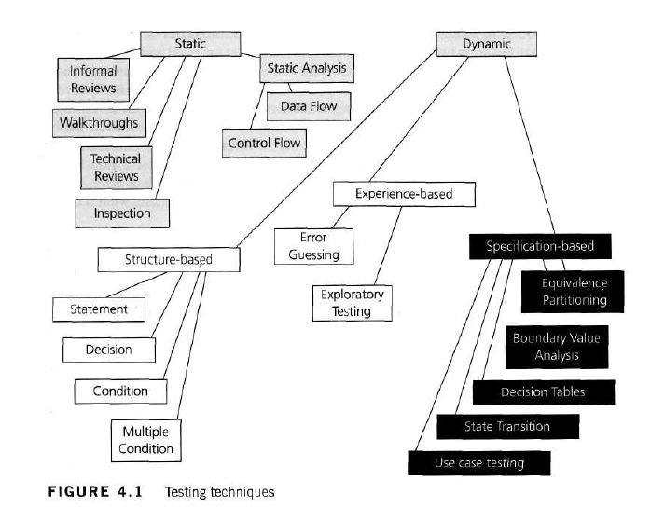
Test Design techniques

Slide 55
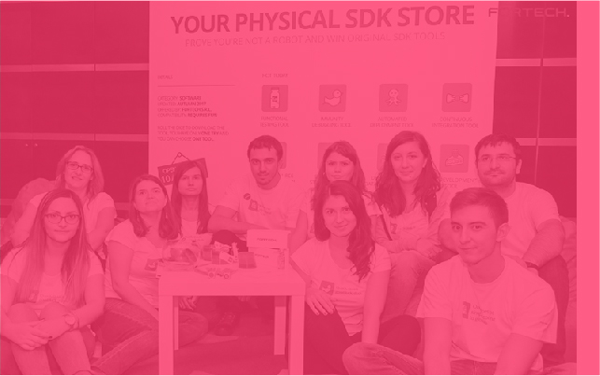
Test Design techniques
Black-Box Test Design techniques
Equivalence partitioning
Boundary Value Analysis
Decision table

Slide 56
Equivalence Partitioning
Divide a set of test conditions into groups or sets that can be considered the same
It can be applied at any level of testing and is often a good technique to use first

Slide 57
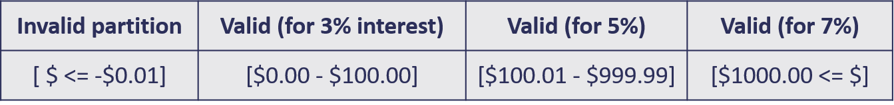
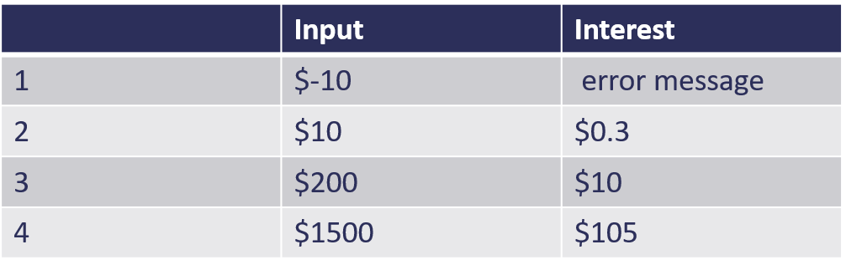
Equivalence Partitioning
Example
A savings account in a bank earns a different rate of interest depending on the balance in the account. A balance in the range $0 up to $100 has a 3% interest rate, a balance over $100 and up to $1000 has a 5% interest rate, and balances of $1000 and over have a 7% interest rate. Balance can’t be negative.
Test Cases (each exercises one partition)

Slide 58
Boundary value analysis
Boundaries at the edge of each equivalence partition is more likely to be incorrect than behavior within the partition, so boundaries are an area where testing is likely to yield defects.
The maximum and minimum values of a partition are its boundary values
When designing test cases, a test for each boundary value is chosen

Slide 59
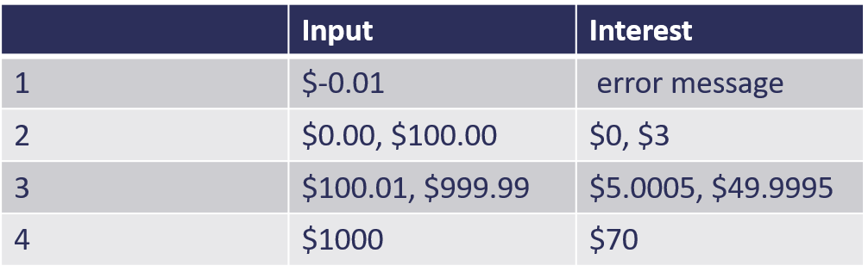
Boundary value analysis
Example
A savings account in a bank earns a different rate of interest depending on the balance in the account. A balance in the range $0 up to $100 has a 3% interest rate, a balance over $100 and up to $1000 has a 5% interest rate, and balances of $1000 and over have a 7% interest rate. Balance can’t be negative.
Test Cases (each exercises one partition)

Slide 60
Decision tables
When creating decision tables, the specification is analyzed, and conditions and actions of the system are identified
Decision tables provide a systematic way of stating complex business rules, which is useful for developers as well as for testers

Slide 61
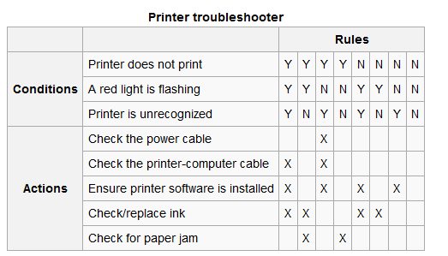
Decision tables
Example: A technical support company writes a decision table to diagnose printer problems based upon symptoms described to them over the phone from their clients

